Slide 1

UNIVERSITY INSTITUTE OF ENGINEERING
ACADEMIC UNIT I & 4
Bachelor of Engineering (Computer Science & Engineering)
Subject Name.-QUANTUM AND SEMICONDUCTOR PHYSICS
Subject Code-20SPT-181
ARMINDER KAUR(E6173)
UNIT 3
QUANTUM MECHANICS
DISCOVER . LEARN . EMPOWER

Slide 2
COURSE OBJECTIVES
The course is designed to make the students industry ready to contribute in the growing demand of the industry at local, national and international level.
It will make the students competent to understand basic concepts and applications of advanced engineering physics and apply its principles in their respective fields at global platform.
It will enhance the skill level of the students and shall make them preferred choice for getting employment in industry and research labs.
It will give thorough knowledge of the discipline to enable students to disseminate knowledge in pursuing excellence in academic areas.

Slide 3

COURSE OUTCOME
CO Number | Title On completion of this course, the students are expected to learn | Level
CO1 | The basic concepts of crystallography and apply its principles in determination of various crystal structures. | Understand Applying
CO2 | The basic concepts of semiconductor physics, illustrate the working of various semiconductor components and use its principles in design of devices and its applications. | Understand Applying Analyze Design
CO3 | The working principle of various lasers, identify its components and justify their importance and applications in different fields of technology. | Understand Applying Analyze
CO4 | The working principle of optical fibre, predict the various losses and recommend its wide applications mainly in communication. | Understand Applying Analyze
CO5 | The basic concepts of quantum mechanics, use its principles in solving quantum mechanical problems and recommend its applications in quantum computing and nanotechnology. | Understand Applying

Slide 4
LECTURE OBJECTIVE
Students will learn about what is nanotechnology
Students will understand how nanotechnology develop.
Students will learn about applications of nanotechnology.

Slide 5
CONTENT
Introduction
Benefits
History
Applications

Slide 6
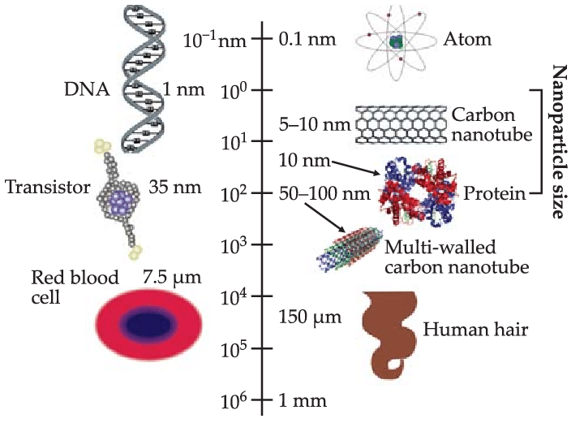
INTRODUCTION
Nanomaterials are typically between 1 and 100 nanometres (nm) in size – with 1 nm being equivalent to one billionth of a metre (10⁻⁹ m).
Figure 1: comparison of nano size with other lengths [1]

Slide 7
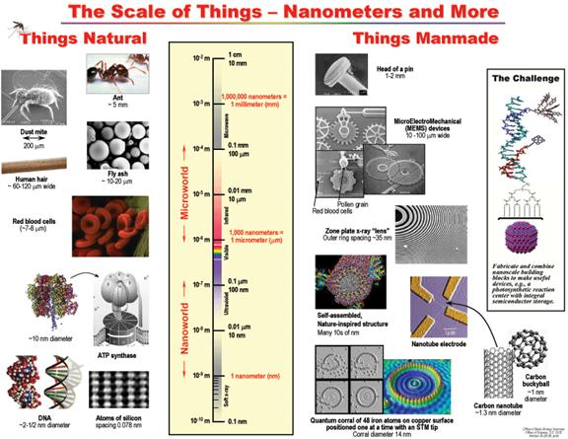
INTRODUCTION
Figure 2: comparison of nano size with other lengths [2]

Slide 8
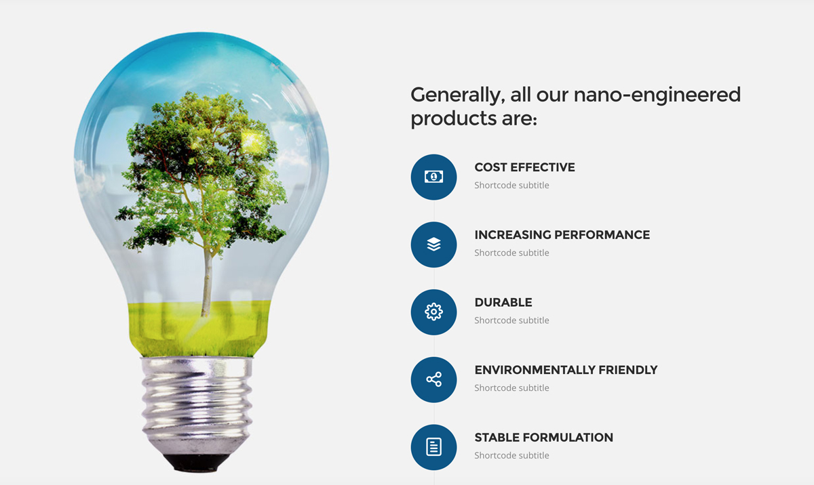
BENEFITS
This is the scale at which the basic functions of the biological world operate and materials of this size display unusual physical and chemical properties. These profoundly different properties are due to an increase in surface area compared to volume as particles get smaller – and also the grip of weird quantum effects at the atomic-scale.
Figure 3: advantages of nano-materials [3]

Slide 9
HISTROY
The idea of nanotechnology was born in 1959 when physicist Richard Feynman gave a lecture exploring the idea of building things at the atomic and molecular-scale.
However, experimental nanotechnology did not come into its own until 1981, when IBM scientists in Zurich, Switzerland, built the first scanning tunnelling microscope (STM). This allows us to see single atoms by scanning a tiny probe over the surface of a silicon crystal.
In 1990, IBM scientists discovered how to use an STM to move single xenon atoms around on a nickel surface – in an iconic experiment, with an inspired eye for marketing, they moved 35 atoms to spell out “IBM”.

Slide 10
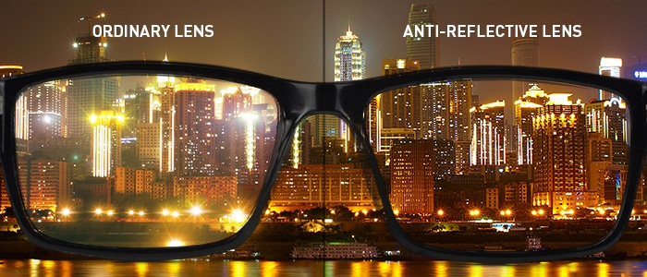
POTENTIAL APPLICATIONS
Clear nanoscale films on eyeglasses, computer and camera displays, windows, and other surfaces can make them water- and residue-repellent, antireflective, self-cleaning, resistant to ultraviolet or infrared light, antifog, antimicrobial, scratch-resistant, or electrically conductive.
Figure 4: view of surrounding from ordinary lens and anti-reflective lens [4]

Slide 11
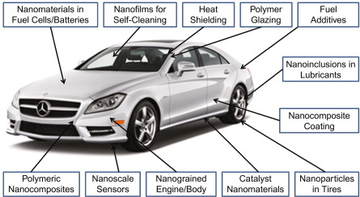
POTENTIAL APPLICATIONS
Nano-engineered materials in automotive products include high-power rechargeable battery systems; thermoelectric materials for temperature control; tires with lower rolling resistance; high-efficiency/low-cost sensors and electronics; thin-film smart solar panels; and fuel additives for cleaner exhaust and extended range.
Figure 5: example of nanotechnology in an automobile [5]

Slide 12
POTENTIAL APPLICATIONS
Nanoparticles are used increasingly in catalysis to boost chemical reactions. This reduces the quantity of catalytic materials necessary to produce desired results, saving money and reducing pollutants.
Transistors, the basic switches that enable all modern computing, have gotten smaller and smaller through nanotechnology. At the turn of the century, a typical transistor was 130 to 250 nanometres in size. In 2014, Intel created a 14-nanometre transistor, then IBM created the first seven nanometre transistor in 2015, and then Lawrence Berkeley National Lab demonstrated a one nanometre transistor in 2016 Smaller, faster, and better transistors may mean that soon your computer’s entire memory may be stored on a single tiny chip.

Slide 13
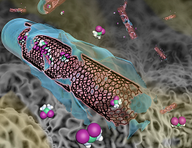
POTENTIAL APPLICATIONS
Nanotechnology researchers are working on a number of different therapeutics where a nanoparticle can encapsulate or otherwise help to deliver medication directly to cancer cells and minimize the risk of damage to healthy tissue. This has the potential to change the way doctors treat cancer and dramatically reduce the toxic effects of chemotherapy.
Figure 6: carbon nanotubes for fighting cancer [6]

Slide 14
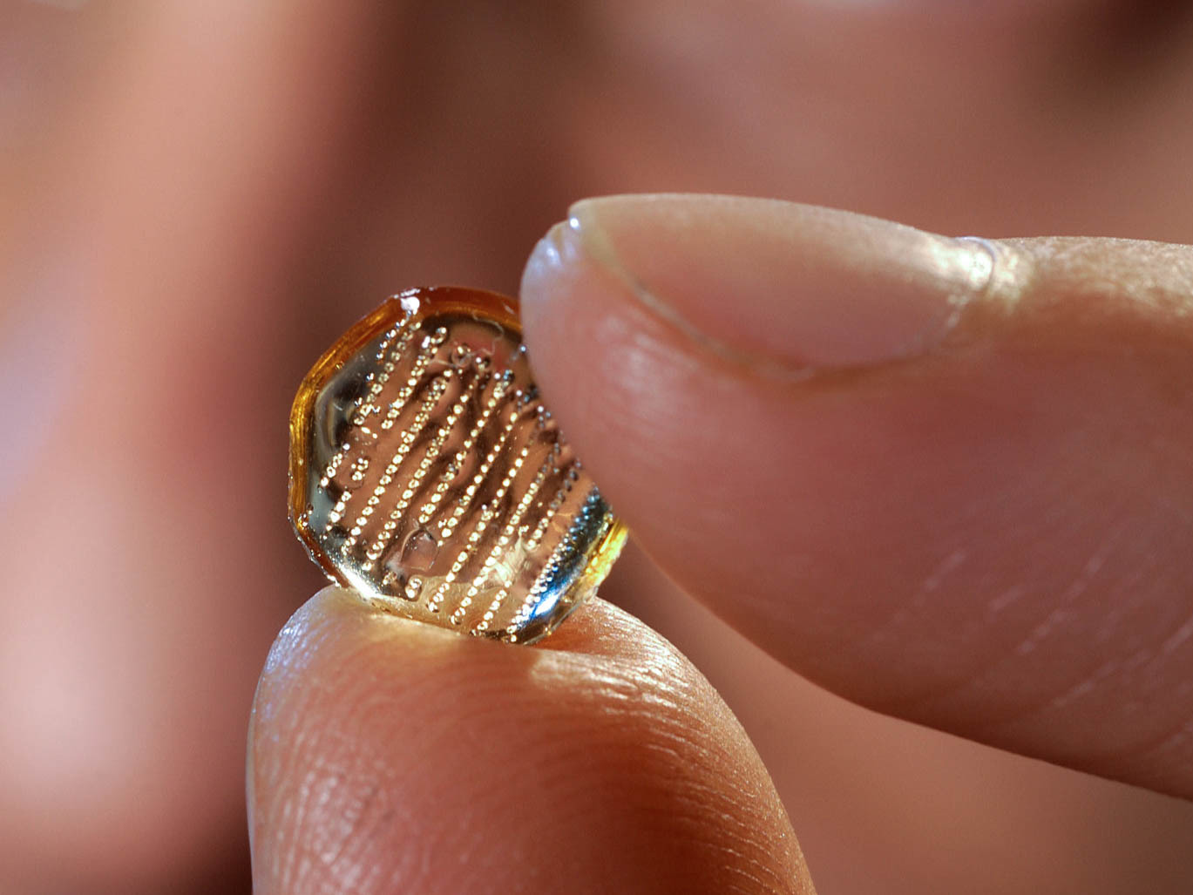
POTENTIAL APPLICATIONS
Nanomedicine researchers are looking at ways that nanotechnology can improve vaccines, including vaccine delivery without the use of needles. Researchers also are working to create a universal vaccine scaffold for the annual flu vaccine that would cover more strains and require fewer resources to develop each year.
Figure 7: The microneedles attached to this patch dissolve after being pressed into skin, releasing a dose of vaccine. Each microneedle is less than a millimeter in length [7]

Slide 15
POTENTIAL APPLICATIONS
Nanoparticles are being developed to clean industrial water pollutants in ground water through chemical reactions that render the pollutants harmless. This process would cost less than methods that require pumping the water out of the ground for treatment.
Researchers are investigating carbon nanotube “scrubbers” and membranes to separate carbon dioxide from power plant exhaust.
Nanotechnology is already being used to develop many new kinds of batteries that are quicker-charging, more efficient, lighter weight, have a higher power density, and hold electrical charge longer

Slide 16
SUMMARY
Nanomaterials are typically between 1 and 100 nanometres (nm) in size.
The idea of nanotechnology was born in 1959 when physicist Richard Feynman gave a lecture exploring the idea of building things at the atomic and molecular-scale.
Nanoscale additives to or surface treatments of fabrics can provide lightweight ballistic energy deflection.
Transistors, the basic switches that enable all modern computing, have gotten smaller and smaller through nanotechnology.
Nanotechnology is being studied for both the diagnosis and treatment of atherosclerosis, or the build-up of plaque in arteries.
Researchers are investigating carbon nanotube “scrubbers” and membranes to separate carbon dioxide from power plant exhaust.

Slide 17
FAQ
Define nanomaterials and compare this size with other materials.
Enlist some applications of nanotechnology in transportations.
How nanotechnology is being used in using energy efficiently.

Slide 18
REFERENCES
https://www.newscientist.com/article/dn9939-introduction-nanotechnology/#ixzz6UEWrLASu
https://www.nano.gov/you/nanotechnology-benefits
https://www.azonano.com/article.aspx?ArticleID=1134#_What_is_Nanotechnology?
https://www.newscientist.com/article/dn9939-introduction-nanotechnology/

Slide 19
IMAGES REFERENCES
[1] https://www.researchgate.net/figure/THE-MICROCOSM-The-nanoscale-includes-proteins-but-excludes-simple-atoms-which-are-too_fig1_301733368
[2] https://www.understandingnano.com/introduction.html
[3] https://www.tctnanotech.com/nanotechnology-benefits/
[4] https://www.stantonoptical.com/blog/anti-reflective-lens-coating
[5] https://www.sciencedirect.com/science/article/pii/S1018364717310868
[6] https://cancer-nano.biomedcentral.com/
[7] https://www.npr.org/sections/health-shots/2017/07/23/537287781/beyond-the-nasty-needle-trying-to-make-vaccines-more-comfy-and-convenient

Slide 20
REFERENCES
VIDEO LINKS
https://www.youtube.com/watch?v=k61wjab7iUs
https://www.youtube.com/watch?v=0MzIh7wkgMs
https://www.youtube.com/watch?v=bKh4cwAygPM
BOOKS
Sahni V., Goswami D. (2008) Nano Computing, McGraw Hill Education Asia Ltd., ISBN: 978007024892Beiser A., Ghatak A, Garg S.C., Applied Physics, Edition 1st, (2013), Tata McGraw-Hill, Noida.

Slide 21
THANK YOU
For queries
Email: surbhi.uis@cumail.in

